Slide 1

Translator Project
text.speech.visual
Proudly presented by group R2

Slide 2

About our Project:
Our Project is a Translator, and our theme is on travels. We chose to do this because this project would help tourists understand different languages people speak in different countries, which makes their travelling experience a more enjoyable and understandable one. Our Translator Mainly Focuses on 3 main components:
Text translation -> user enters text, translated text comes out
Visual Translation -> user scans a text, translated text comes out
Audio Translation -> user speak, translated text comes out

Slide 3

BELOW ARE INDIVIDUAL DESCRIPTIONS OF DIFFERENT TRANSLATORS

Slide 4
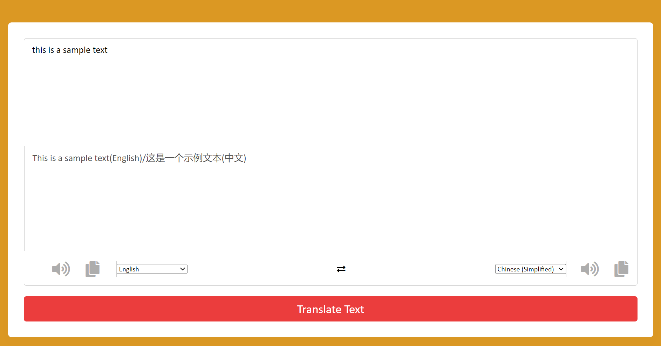
TEXT TRANSLATION
This text is entered by the user
This is the translated text
You can hear the text entered/translated
You can also copy the texts
Select text to be translated
Select text to translate to

Slide 5
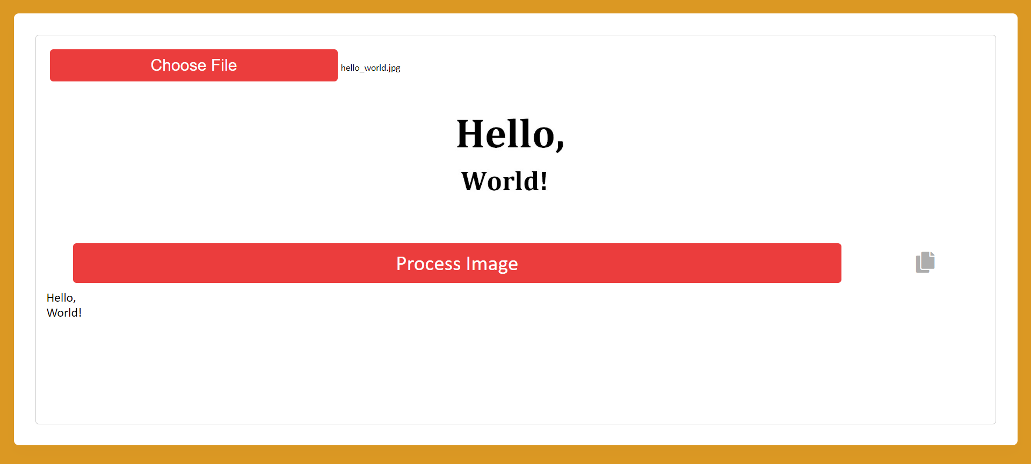
VISUAL TRANSLATION
This is a display of the image selected
User selects an image file
This is the scanned text
User can then copy the scanned text

Slide 6
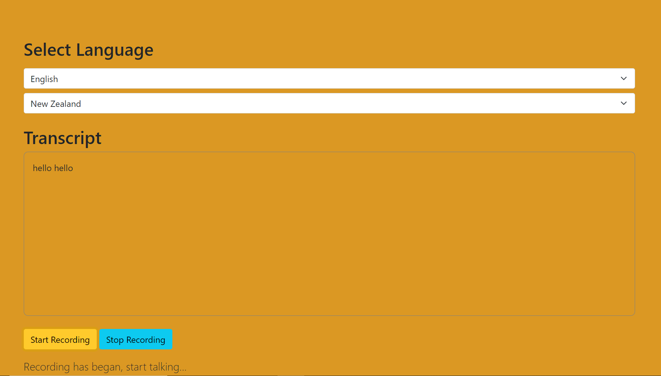
AUDIO TRANSLATION
Language to detect/translate
Select region of language
Text box in which translation/detected audio appears
Click to start or end recording

